Slide 1


Open Citations as Academic & Cultural Capital Reducing inequality in the communication & evaluation of science
Catriona J. MacCallum
Director of Open Science, Hindawi
Bologna Sept 2018
ORCID 0000-0001-9623-2225
@Hindawi @catmacOA

Slide 2



Open Access since 2007
~18,000 peer-reviewed articles a year
Science, Technology & Medicine
A founding member of OASPA
Free access – no charge to access
No embargos – immediately available
Reuse – Creative Commons Attribution License (CC BY) - use with proper attribution

Slide 3


September 2017
November 2016

Slide 4
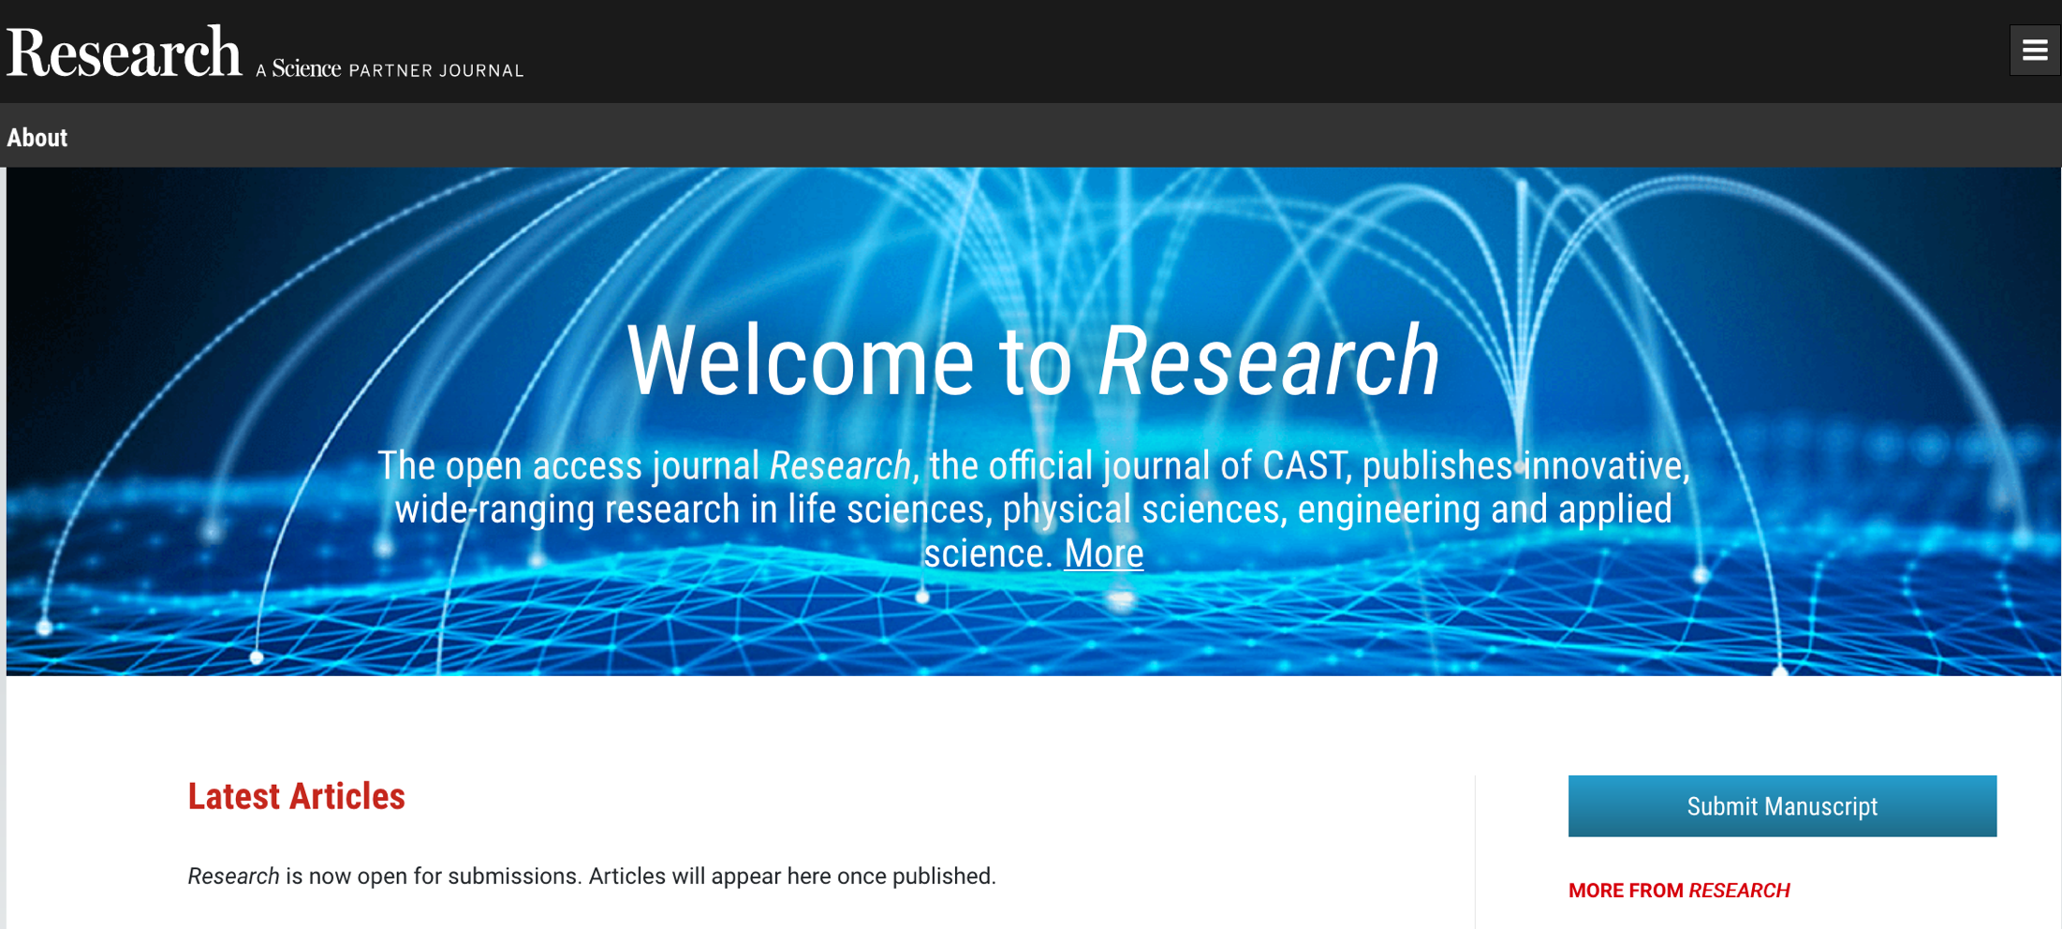
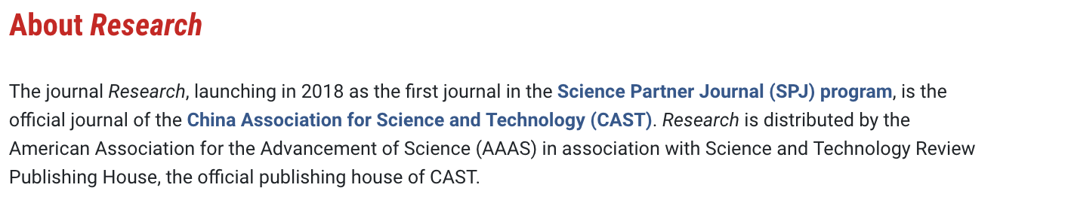

Slide 5
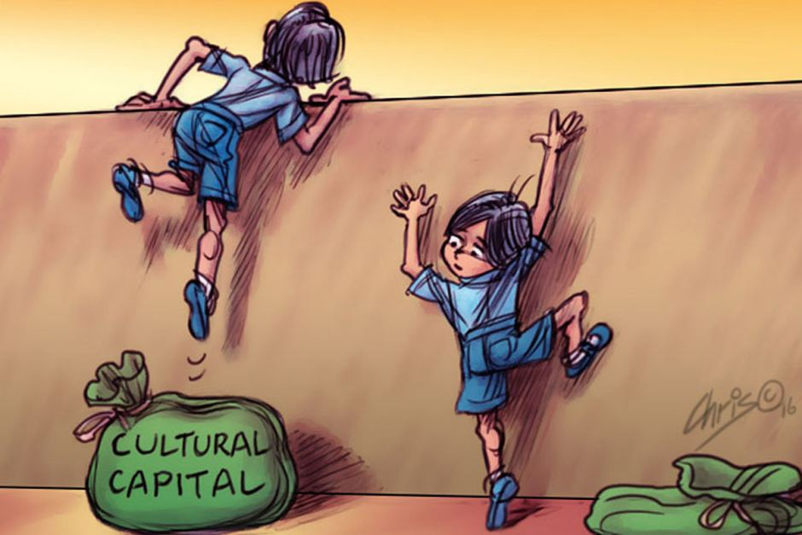
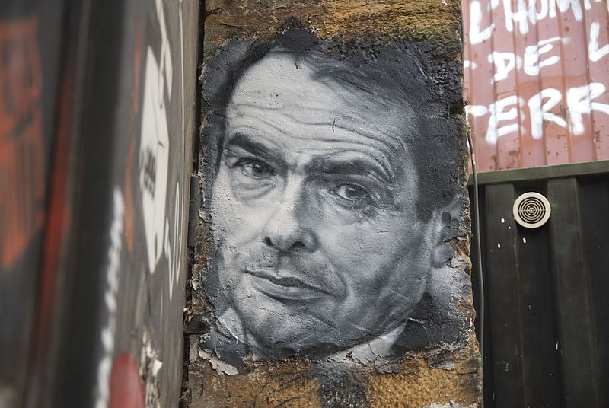
Health Warning
ABC news: http://www.abc.net.au/news/2018-04-13/cultural-capital/9613460 (not sure about copyright)
Photo of Pierre Bourdieu painting by Thierry Ehrmann (CC BY): https://commons.wikimedia.org/wiki/File:Pierre_Bourdieu,_painted_portrait_DDC_8931.jpg

Slide 6
Academic capital is the potential of an individual’s education and other academic experience to be used to gain a place in society. … academic capital … is made up of many different factors, including the individual's academic transmission from his/her family, status of the academic institutions attended, and publications produced by the individual.
Cultural capital refers to assets, e.g., competencies, skills, qualifications, which enable holders to mobilise cultural authority and can also be a source of misrecognition and symbolic violence. … A key part of this process is the transformation of people's symbolic or economic inheritance (e.g., accent or property) into cultural capital (e.g., university qualifications).
Academic Status
Prestige & Reputation
cultural assets that promote academic mobility
Academic qualifications
Institutional rank & publications
https://en.wikipedia.org/wiki/Academic_capital
https://en.wikipedia.org/wiki/Cultural_capital

Slide 7
Cultural Capital
The objective mechanisms which enable the ruling class to keep the monopoly of the most prestigious educational establishments, while continually appearing at least to put the chance of possessing that monopoly into the hands of every generation, are concealed beneath the cloak of a perfectly democratic method of selection which takes into account only merit and talent, and these the members of the dominated classes whom they eliminate in the same way as they convert those whom they elect, and which ensures that those who are ‘miraculously elected’ may experience as miraculous an exceptional destiny which is the best testimony of academic democracy.
The current evaluation system prides itself on a system based on meritocracy when it is not based on real merit at all
Bourdieu, P. (1973). Cultural Reproduction and Social Reproduction. In R. Brown (Ed.), Knowledge, Education, and Cultural Change (pp. 71-112). London: Tavistock Publications Limited.

Slide 8
Open citations is about increasing equality of opportunity
Notes:
Institutions
Funders
Publishers
ECRs
Global distribution of knowledge

Slide 9
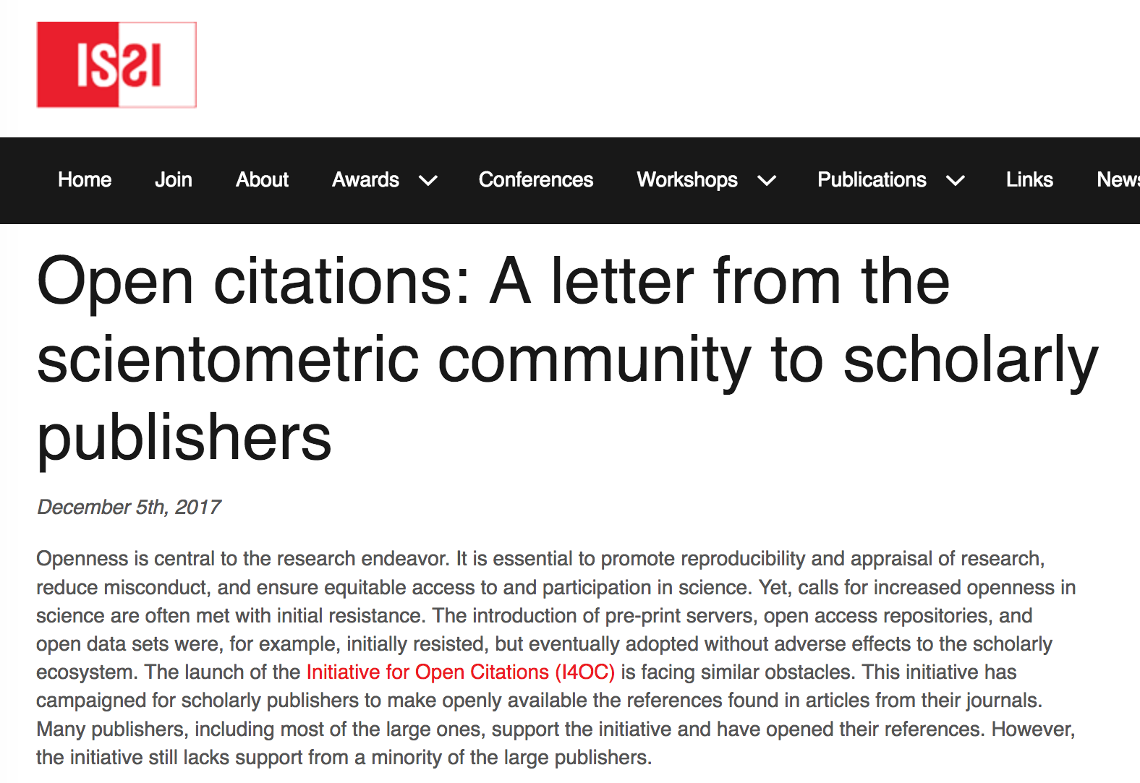
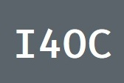
Why do we need open citations?
Dec 2017
The ability to undertake large-scale and generalizable bibliometric research … is limited to a few well-funded centers that can afford to pay for full access to the raw data of Web of Science or Scopus.
…scientometricians need a data source that is freely available and comprehensive. This is a matter of scientific integrity, scientific progress, and equity
Scientometrics is widely used to support science policy and research evaluation, with consequences for the entire scientific community. There is a need for specialized organizations, both commercial and non-commercial, that offer scientometric services.
...to guarantee full transparency and reproducibility of scientometric analyses, these analyses need to be based on open data sources.
advocating for open references is critical to ensure replicable and equitable research practices.
We should use our relationships with journals—as authors, reviewers, and editorial board members—to advocate for openness and should expect scientometric journals to be leaders in this respect.
“References are a product of scholarly work and represent the backbone of science—demonstrating the origin and advancement of knowledge—and provide essential information for studying science and making decisions about the future of research. References are generated by the academic community and should be freely available to this community.”

Slide 10
Amsterdam Call For Action April 2016 https://english.eu2016.nl/latest/news/2016/04/05/eu-action-plan-for-open-science
Open Science
“Open science is about the way researchers work, collaborate, interact, share resources and disseminate results.
….will bring huge benefits for science itself, as well as for its connection with society. “

Slide 11

Open Science?
Jeff Rouder‏
@JeffRouder
What is Open Science? It is endeavoring to preserve the rights of others to reach independent conclusions about your data and work.
8:47 PM - 5 Dec 2017
Why
+
Open Infrastructure
X
Open Science
Open Outputs
Culture
(change)
=
(& Open Standards)
How
Access, reuse &
discoverability
Evaluation &
Researcher behaviour

Slide 12
Opportunities
Technological: to create a truly open and reusable technical infrastructure for scholarly communication.
Economic: to fundamentally shift the business relationships between scholarly publishers and the research community from a model based on ownership, control, and journal brands to one based on value-added services, collaborative partnerships, and community engagement.
Cultural: to decouple the communication of scholarly work from its evaluation, in particular removing journal competition and evaluation as a proxy of the quality of individual outputs and researchers, which has been a key barrier to realising these technological and economic opportunities.
MacCallum, CJ (2018) An Open Science future – Europe leads the way, Hindawi Blog https://about.hindawi.com/blog/an-open-science-future-europe-leads-the-way/

Slide 13
The Oligopoly of Academic Publishers in the Digital Era
Disciplines | 1973 | Mid 1990s | 2013 | Relative Share 2013
Natural and Medical Sciences | 20% | 30% | 53% | 47% by Reed-Elsevier, Springer, Wiley-Blackwell ~6% T&F and Am. Chem. Society
Social Sciences & Humanities | 10% | 15% | 51% | Elsevier 16.4% T&F 12.4% Wiley-Blackwell 12.1% Springer 7.1% Sage 6.4%
Larivière V, Haustein S, Mongeon P (2015) The Oligopoly of Academic Publishers in the Digital Era. PLOS ONE 10(6): e0127502. doi:10.1371/journal.pone.0127502
http://journals.plos.org/plosone/article?id=10.1371/journal.pone.0127502

Slide 14
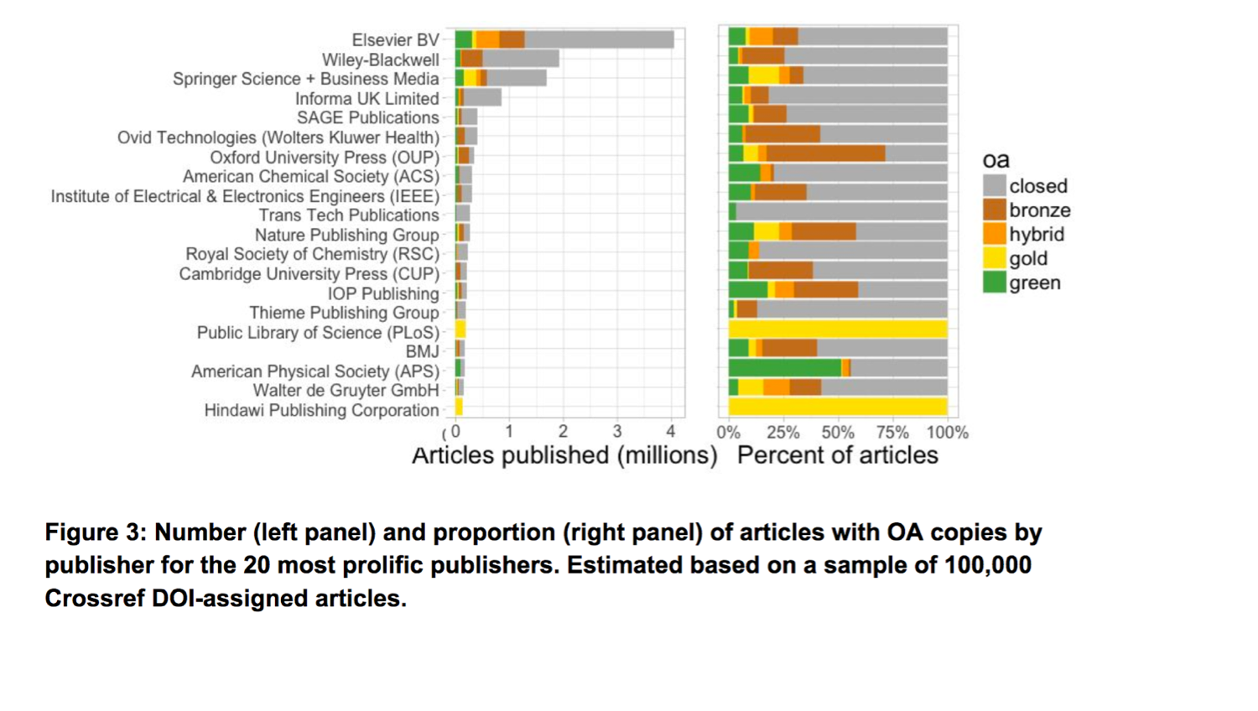
Open Access by publisher
CC BY Piwowar H, Priem J, Larivière V, Alperin JP, Matthias L, Norlander B, Farley A, West J, Haustein S. (2017) The State of OA: A large-scale analysis of the prevalence and impact of Open Access articles. PeerJ Preprints 5:e3119v1 https://doi.org/10.7287/peerj.preprints.3119v1

Slide 15

Of the top-20 biggest publishers with citation data, all but five now make these data open via Crossref. Three represent Scholarly Societies…

Slide 16
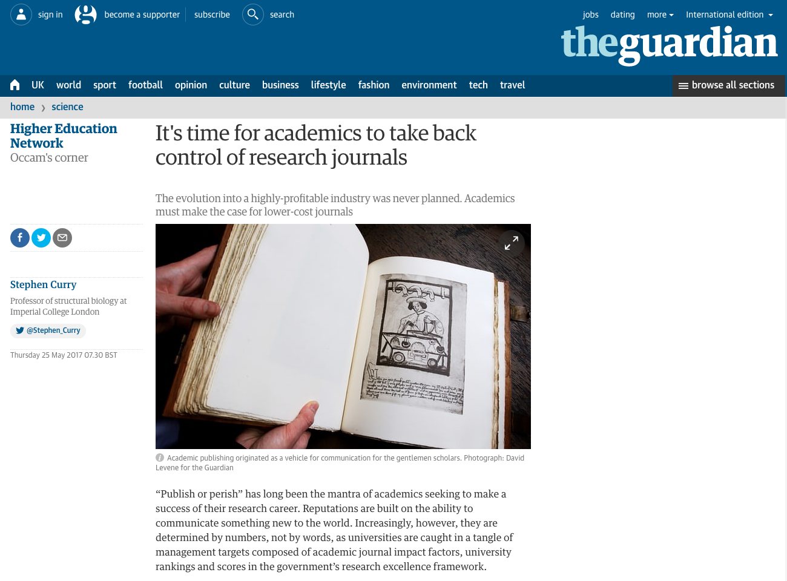
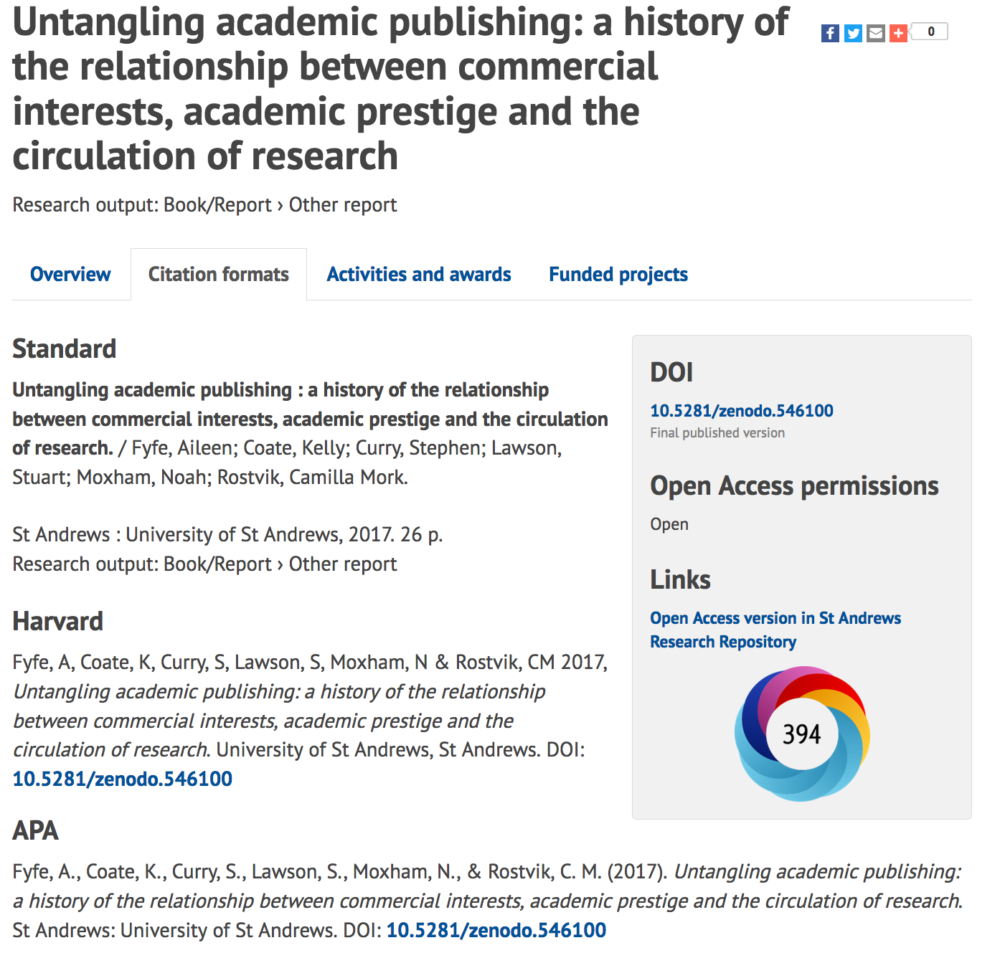

Slide 17
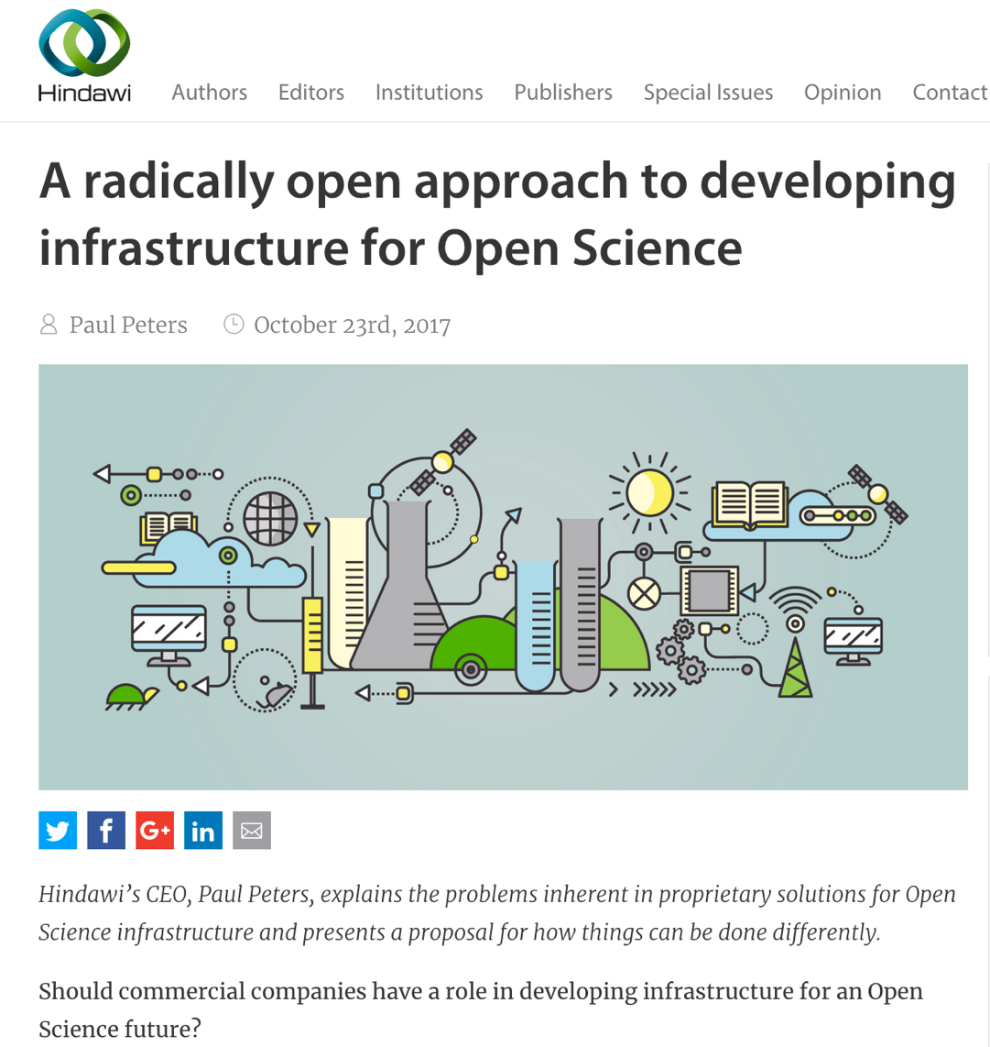
Open Source
prevents monopolistic control
requires an active community of users and service providers to develop and maintain infrastructure
Open Data
metadata about the research process itself, such as funding data, publication and citation data, and “altmetrics” data
Open Integrations
standard metadata formats and open APIs
Open Contracts
completely open (public) and no lock-in (e.g. Non-Disclosure Agreements, multi-year contract terms, and privately negotiated prices)
most of the data needed to support Open Science is controlled by commercial companies, both big and small. This growing reliance on a handful of companies to provide proprietary analytics and decision tools for research funders and universities poses serious risks for the future

Slide 18

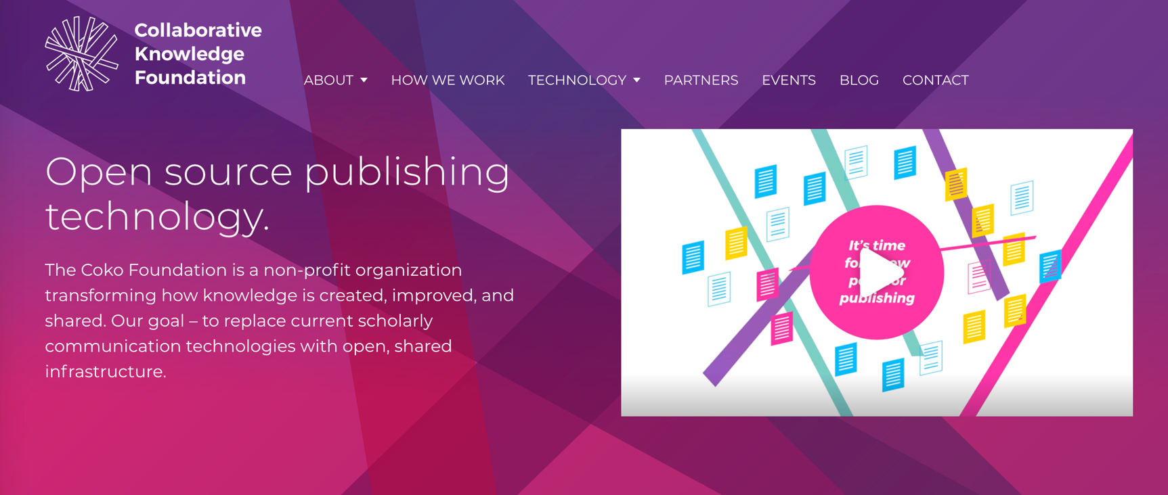

Slide 19
Publisher as service provider
Open Access (CC BY)
Encourage and facilitate better forms of credit
ORCID
CRediT taxonomy
Data /software citations
Protocols
Preprints
Encourage data / software / materials sharing
Provide high quality metadata
Open Citations
Reduce friction
Enable connections and discovery
Adopt relevant persistent identifiers
Reduce the burden on researchers
Reduce the burden for funders and institutions
Enable a machine readable ecosystem
An Open Infrastructure
Charge for services not outputs

Slide 20
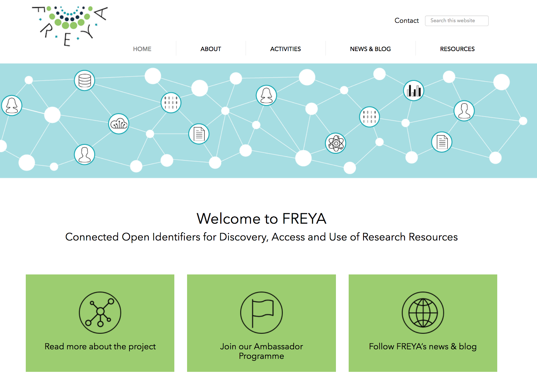
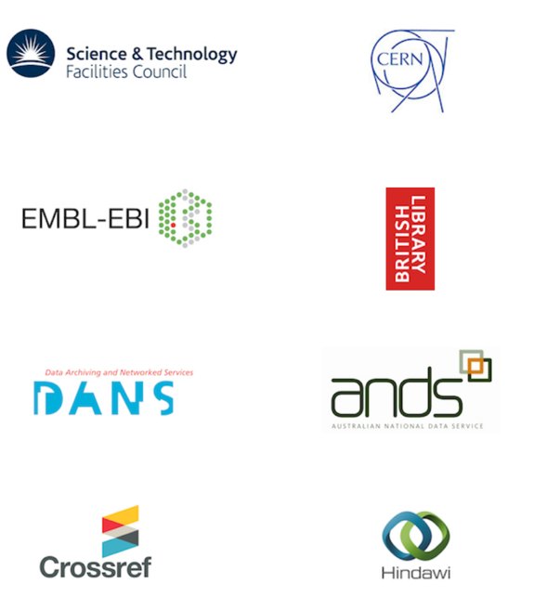



Project FREYA

Slide 21
“Current incentive structures in science, combined with existing conventions such as a significance level of 5%, encourage rational scientists to adopt a research strategy that is to the detriment of the advancement of scientific knowledge.“
Higginson AD, Munafò MR (2016) Current Incentives for Scientists Lead to Underpowered Studies with Erroneous Conclusions. PLoS Biol 14(11): e2000995. https://doi.org/10.1371/journal.pbio.2000995

Slide 22
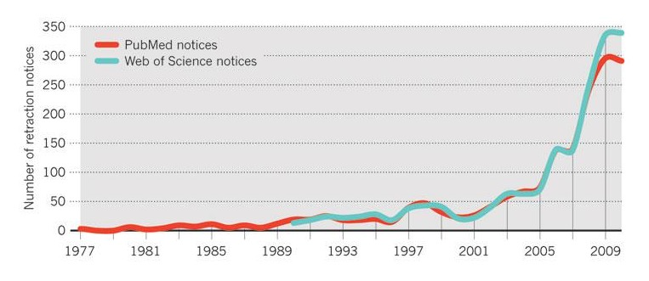
Retraction trends
In same period, volume of papers increased by 44%
Van Noorden, Nature 478, 26-28 (2011)

Slide 23
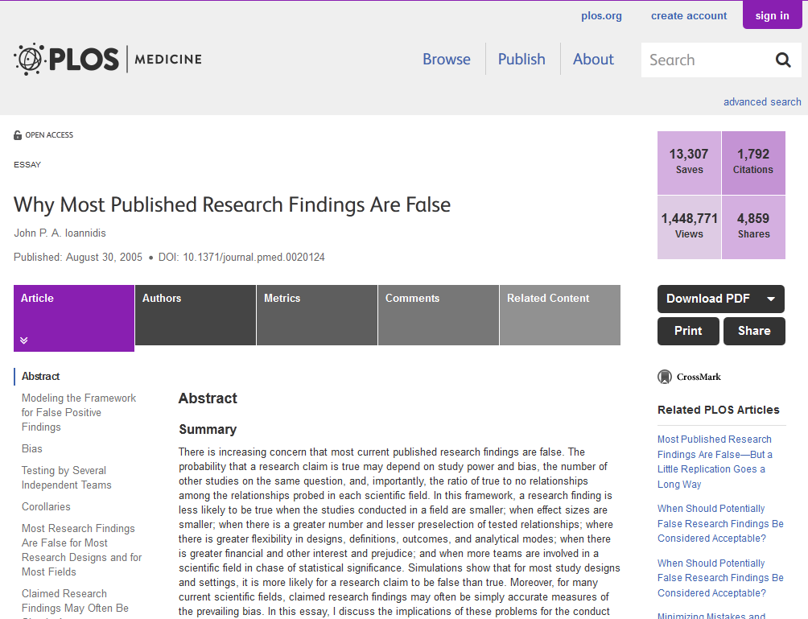
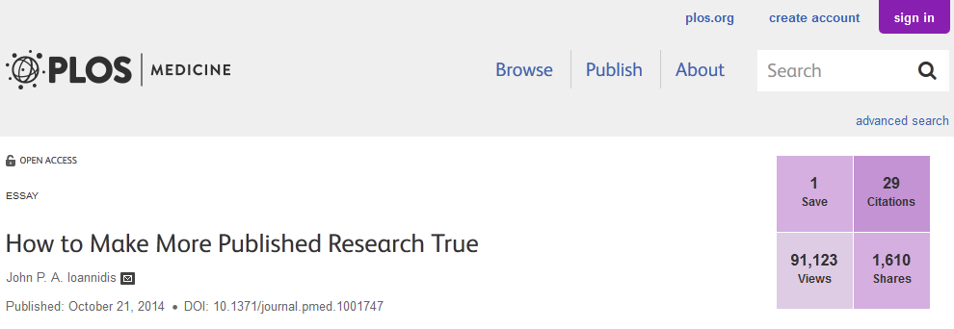
Is science (communication) trustworthy?
Science Communication
Poorly Designed studies
small sample sizes, lack of randomisation, blinding and controls
‘p-hacking’ (selective analyses) widespread¹
Poorly reported methods & results²
Negative/inconclusive results are not published
Data not available to scrutinise/replicate
¹Head ML, Holman L, Lanfear R, Kahn AT, Jennions MD (2015) The Extent and Consequences of P-Hacking in Science. PLoS Biol 13(3): e1002106. doi:10.1371/journal.pbio.1002106
²Landis SC, et al. (2012) A call for transparent reporting to optimize the predictive value of preclinical research. Nature 490(7419): 187–191.

Slide 24
Does prestige ensure ‘quality’?
Higher ranked journals have more papers retracted¹
Papers in higher ranked journals are more likely to report either no or inappropriate statistics^{2,3}
Papers from highly ranked institutions have poorer reporting standards³
¹Fang, Ferric C., and Arturo Casadevall. “Retracted Science and the Retraction Index.” Infection and Immunity 79, no. 10 (October 1, 2011): 3855–59. doi:10.1128/IAI.05661-11.
²Tressoldi PE, Giofre D, Sella F, Cumming G. High impact = high statistical standards? Not necessarily so. PLOS ONE 2013; 8(2):e56180. doi: 10.1371/journal.pone.0056180 PMID: 23418533
³ Macleod MR, et al. (2015) Risk of Bias in Reports of In Vivo Research: A Focus for Improvement. PLOS Biol 13(10): e1002273. doi:10.1371/journal.pbio.1002273

Slide 25
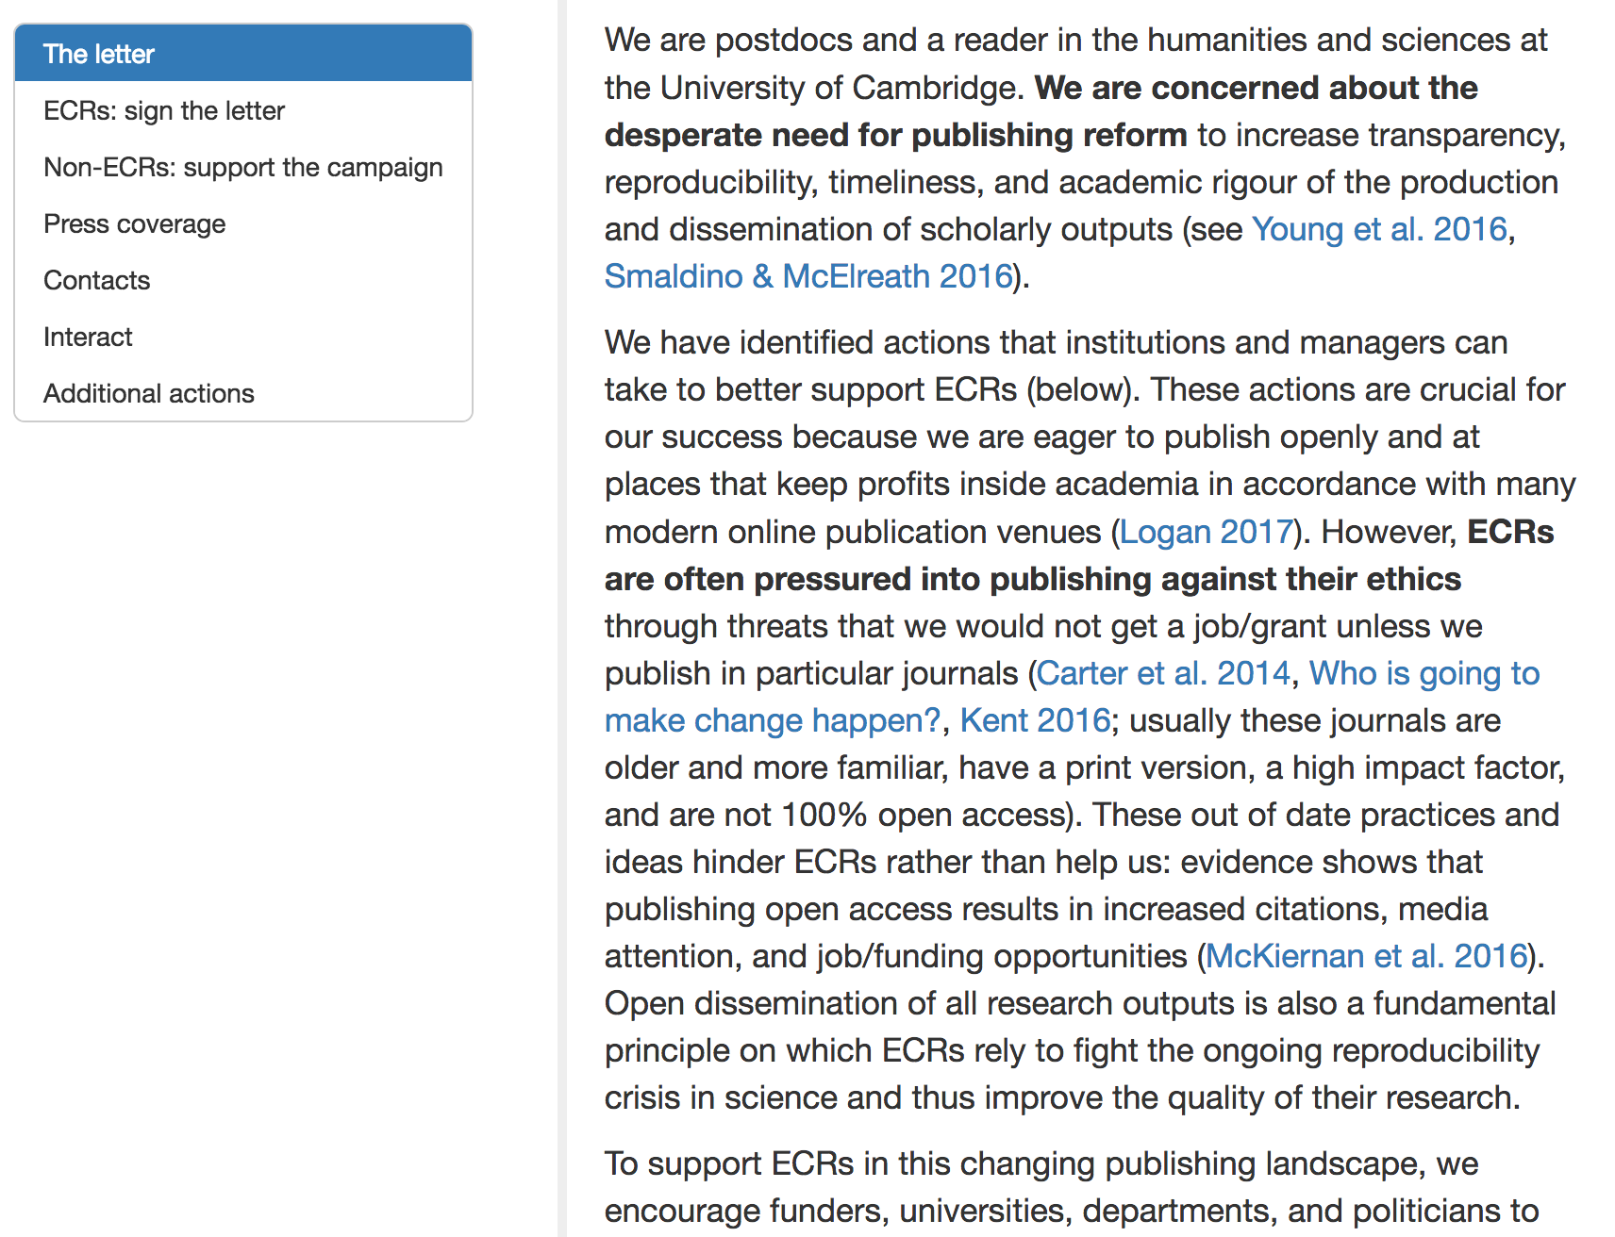
Bullied into bad science
The Bullied Into Bad Science campaign is an initiative by early career researchers (ECRs) for early career researchers who aim for a fairer, more open and ethical research and publication environment.
(University of Cambridge)
http://bulliedintobadscience.org/

Slide 26
Rescuing US biomedical research from its systemic flaws Bruce Alberts , Marc W. Kirschner , Shirley Tilghman, and Harold Varmus PNAS | April 22, 2014 | vol. 111 | no. 16 | 5773–5777 doi: 10.1073/pnas.1404402111
“As competition for jobs and promotions increases, the inflated value given to publishing in a small number of so-called “high impact” journals has put pressure on authors to rush into print, cut corners, exaggerate their findings, and overstate the significance of their work.
Such publication practices, abetted by the hypercompetitive grant system and job market, are changing the atmosphere in many laboratories in disturbing ways.”

Slide 27
Hypercompetition 1
Selection for high output leads to poorer methods and increasingly high false discovery rates.
Replication slows but does not stop methodological deterioration.
Common methodologies can change over time not only because established researchers are strategically changing their methods, but also because certain researchers are more successful in transmitting their methods to younger generations.
between 1974 and 2014, the frequency of the words ‘innovative’, ‘groundbreaking’ and ‘novel’ in PubMed abstracts increased by 2500% or more.
Smaldino, Paul E., and Richard McElreath. “The Natural Selection of Bad Science.” Royal Society Open Science 3, no. 9 (September 21, 2016). https://doi.org/10.1098/rsos.160384. and refs within
Notes:
Institutions
Funders
Publishers
ECRs
Global distribution of knowledge

Slide 28
Hypercompetition 2
volume alone is often perceived as a measure of researcher quality, particularly for early-career researchers (who don’t have citations).
since the adoption of the h-index, researchers have been observed to artificially inflate their indices through self-citation.
positive results in support of some novel hypothesis are more likely to be published than negative results, particularly in high-impact journals.
researchers who can obtain more positive results—whatever their truth value—will have an advantage
Researchers don't publish negative research
even firmly discredited research is often cited by scholars unaware of the discreditation.
Smaldino, Paul E., and Richard McElreath. “The Natural Selection of Bad Science.” Royal Society Open Science 3, no. 9 (September 21, 2016). https://doi.org/10.1098/rsos.160384. and refs within
Notes:
Institutions
Funders
Publishers
ECRs
Global distribution of knowledge

Slide 29
Perverse Incentives
The more any quantitative social indicator is used for social decision-making, the more subject it will be to corruption pressures and the more apt it will be to distort and corrupt the social processes it is intended to monitor.
Donald T. Campbell (1976, p. 49)
I’ve been on a number of search committees. I don’t remember anybody looking at anybody’s papers. Number and IF [impact factor] of pubs are what counts.
Terry McGlynn (realscientists) (21 October 2015, 4:12 p.m. Tweet.)
Quotes at start of Smaldino, Paul E., and Richard McElreath. “The Natural Selection of Bad Science.” Royal Society Open Science 3, no. 9 (September 21, 2016). https://doi.org/10.1098/rsos.160384.
Notes:
Institutions
Funders
Publishers
ECRs
Global distribution of knowledge

Slide 30
Incentives drive culture & create inequality
The biggest barriers to Open Science are the perverse incentives in the reward and evaluation systems that make authors and other stakeholders reluctant to share
The primacy of publications and the journal as a proxy of quality with which to award grants and assign tenure (the impact factor…)
Financial bonuses
Lack of reward for data and other outputs
Lack of transparency & poor reporting
Publication bias

Slide 31
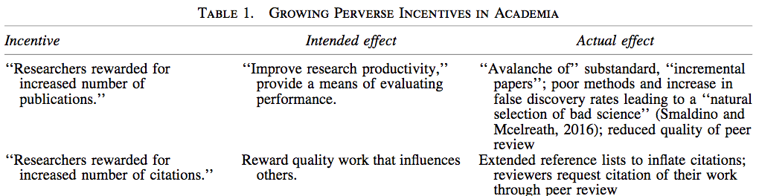
Perverse Incentives…
Edwards, Marc A., and Roy Siddhartha. “Academic Research in the 21st Century: Maintaining Scientific Integrity in a Climate of Perverse Incentives and Hypercompetition.” Environmental Engineering Science 34, no. 1 (2017): 51–61.
Marc A. Edwards and Siddhartha Roy.Environmental Engineering Science.Jan 2017.ahead of print http://doi.org/10.1089/ees.2016.0223

Slide 32
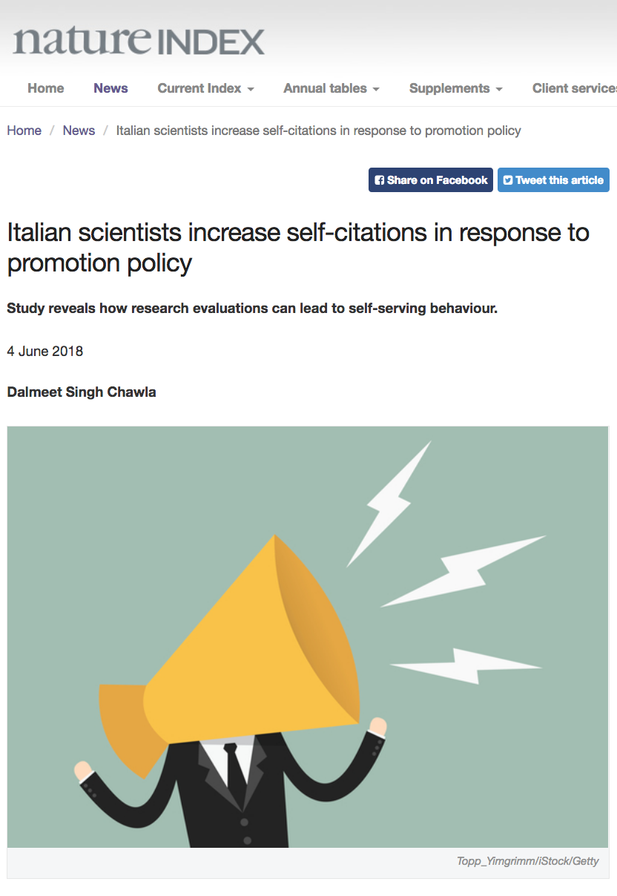
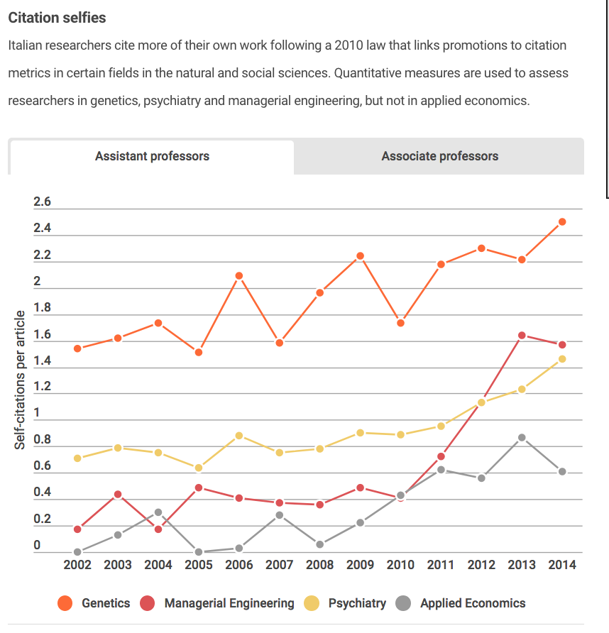
Consequences

Slide 33
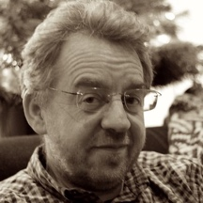
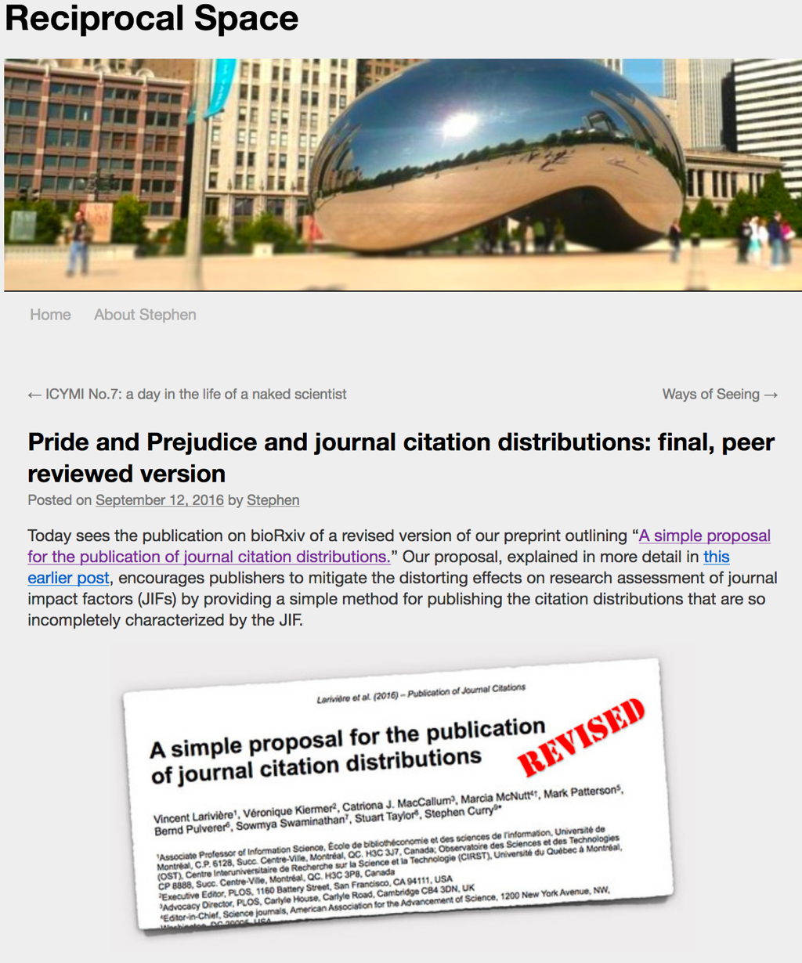
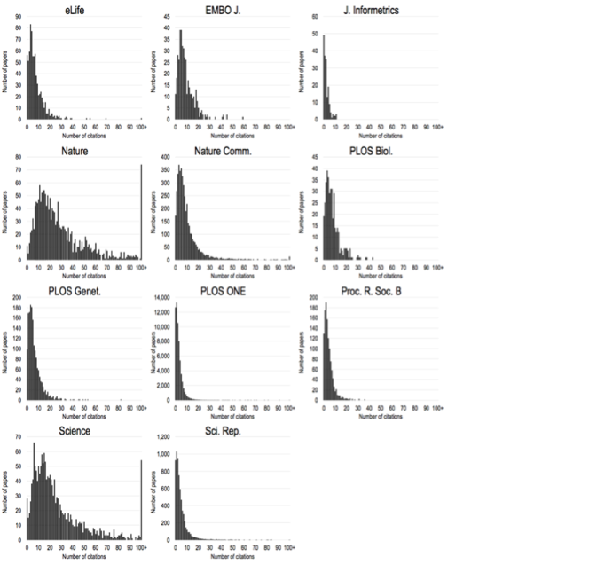
Impact factors mask huge variation in citations - if you use it you are dishonest and statistically illiterate @Stephen_Curry #COASP
COASP7 ‘Research and researcher evaluation’ (2015), Stephen Curry (Imperial College London) – available soon from OASPA website
A simple proposal for the publication of journal citation distributions, 2016 Vincent Lariviere et al bioRxiv 062109; doi: https://doi.org/10.1101/062109

Slide 34
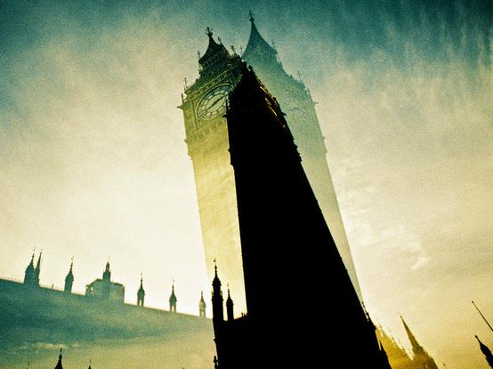




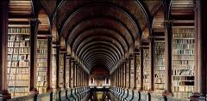




Policy Makers
Researchers (authors and readers)
Institutions
Who cares about measuring research impact?
Publishers
Funders
The public

Slide 35
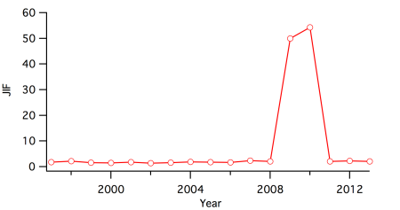
The Acta Crystallographica Section A effect. The plot shows that this journal had a JIF of 2.051 in 2008 which jumped to 49.926 in 2009 due to a single highly-cited paper. Did every other paper in this journal suddenly get amazingly awesome and highly-cited for this period? Of course not.
Steve Royle. “Wrong Number: A Closer Look at Impact Factors.” Quantixed, May 2015. https://quantixed.wordpress.com/2015/05/05/wrong-number-a-closer-look-at-impact-factors/

Slide 36
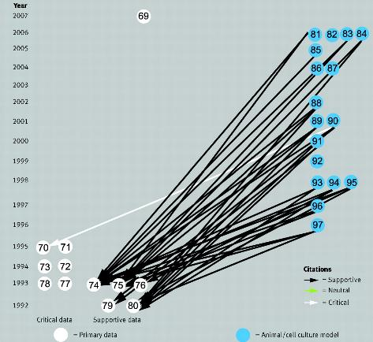
Citation Bias 1
Citations to papers supporting rationale for overproduction of β amyloid precursor protein mRNA as a valid model of inclusion body myositis.
The supportive papers received 94% of the 214 citations to these primary data, whereas the six papers containing data that weakened or refuted the claim received only 6% of these citations
CC BY NC Steven A Greenberg BMJ 2009;339:bmj.b2680 How citation distortions create unfounded authority: analysis of a citation network http://www.bmj.com/content/339/bmj.b2680

Slide 37
Citation Bias 2
Affiliation matters - both to get your paper published and in terms of the number of citations received
As the number of countries represented in the author list increases, articles are more likely to be published in journals with higher impact factors and accrue more citations
In ecology - US and Chinese co-authors publish articles in higher-tier journals than do Chinese authors alone (US alone receive most).
Franco-American collaborations fare better than papers published by either country independently
The publication and citation share of countries in the Global North are decreasing over time, while those of China, India and South Korea are increasing.
Smith MJ, Weinberger C, Bruna EM, Allesina S (2014) The Scientific Impact of Nations: Journal Placement and Citation Performance. PLoS ONE 9(10): e109195. doi:10.1371/journal.pone.0109195
Notes:
Institutions
Funders
Publishers
ECRs
Global distribution of knowledge

Slide 38
Citation Bias 3
existing multidisciplinary journals preferentially concentrate most-cited papers from scientific fields with high citation densities.
They have no or minimal share in the most influential scientific articles of 1/3 of fields examined (8 of the 21), including Mathematics [and...] other sciences with very strong mathematical methodology and rigorous theoretical and applied methods such as Computer Science, Engineering, Space Science, Agricultural Sciences and practically all social sciences (General, Psychiatry/Psychology, Economics)
the journal is the most important factor for a paper to receive citations - even more important than newsworthiness and quality that are also important for predicting future citation impact [13].
Ioannidis, John P. A. “Concentration of the Most-Cited Papers in the Scientific Literature: Analysis of Journal Ecosystems.” PLoS ONE 1, no. 1 (December 20, 2006). https://doi.org/10.1371/journal.pone.0000005.
Notes:
Institutions
Funders
Publishers
ECRs
Global distribution of knowledge

Slide 39
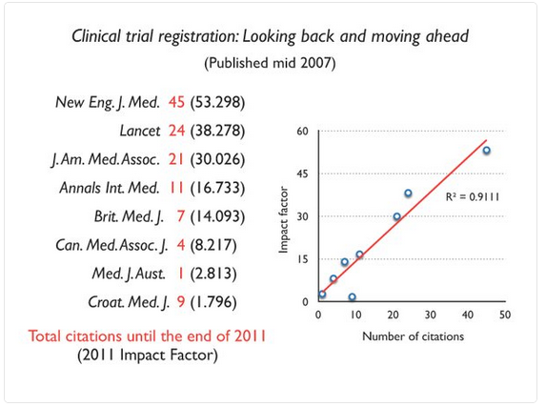
Imperfect Impact
Stuart Cantrill January 23, 2016 Imperfect impact Chemical connections
https://stuartcantrill.com/2016/01/23/imperfect-impact/

Slide 40
Citation Bias 4
The motives for citing a paper are domain-specific. Affected by
geographic location of authors and citers
number of authors
direction of results
the length of a paper and potentially other factors as well [14], [15]
they are almost chaotic to investigate in detail [16]–[18].
there is no guarantee that the most-cited papers would even be “correct” or truly the “best” ones in the field. Controversy and refutation may also sometimes attract debate and citations [22].
In science, most-cited papers may be large tents where hundreds and thousands of scientists are flocking to.
Ioannidis, John P. A. “Concentration of the Most-Cited Papers in the Scientific Literature: Analysis of Journal Ecosystems.” PLoS ONE 1, no. 1 (December 20, 2006). https://doi.org/10.1371/journal.pone.0000005. and refs within
Notes:
Institutions
Funders
Publishers
ECRs
Global distribution of knowledge

Slide 41
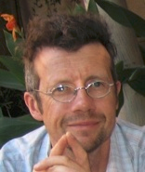
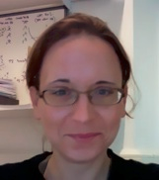
Can Scientists Assess Merit or Predict Impact?
Analysed subjective rankings of papers from two different data sets over five years
Faculty of 1000
Welcome Trust (data from Allen et al. of 2 assessor rankings within 6 months of publication)
In relation to citations and impact factor
Eyre-Walker A, Stoletzki N (2013) The Assessment of Science: The Relative Merits of Post-Publication Review, the Impact Factor, and the Number of Citations. PLoS Biol 11(10): e1001675. doi:10.1371/journal.pbio.1001675
http://www.plosbiology.org/article/info:doi/10.1371/journal.pbio.1001675

Slide 42
Subjective assessments of science are poor:
Very weak correlation between assessors
Strongly biased by the journal in which the paper was published
Number of citations or the impact factor exaggerates differences between papers
Scientists are also poor at predicting the future impact:
Because they are not good at assessing merit
Similar articles accumulate citations essentially by chance.
“What this paper shows is that whatever merit might be, scientists can't be doing a good job of evaluating it when they rank the importance or quality of papers. From the (lack of) correlation among assessor scores, most of the variation in ranking has to be due to ‘error’ rather than actual quality differences.”
Carl Bergstrom , 2013
Eisen JA, MacCallum CJ, Neylon C (2013) Expert Failure: Re-evaluating Research Assessment. PLoS Biol 11(10): e1001677. doi:10.1371/journal.pbio.1001677

Slide 43
What is Quality?
Context dependent
Discipline
Stage of your career
Different levels
Individual
Project
Institutional (rankings…)
National and International
Cannot be distilled into a single number or proxy
Multi-variate
Metrics need to be qualitative as well as quantitative

Slide 44

‘qualities…’
Nicolas Raymond https://www.flickr.com/photos/82955120@N05/8691488200/in/photostream/ CC BY

Slide 45

not ‘quality’

Slide 46
We need to apply the scientific method to the process of scholarly communication itself

Slide 47
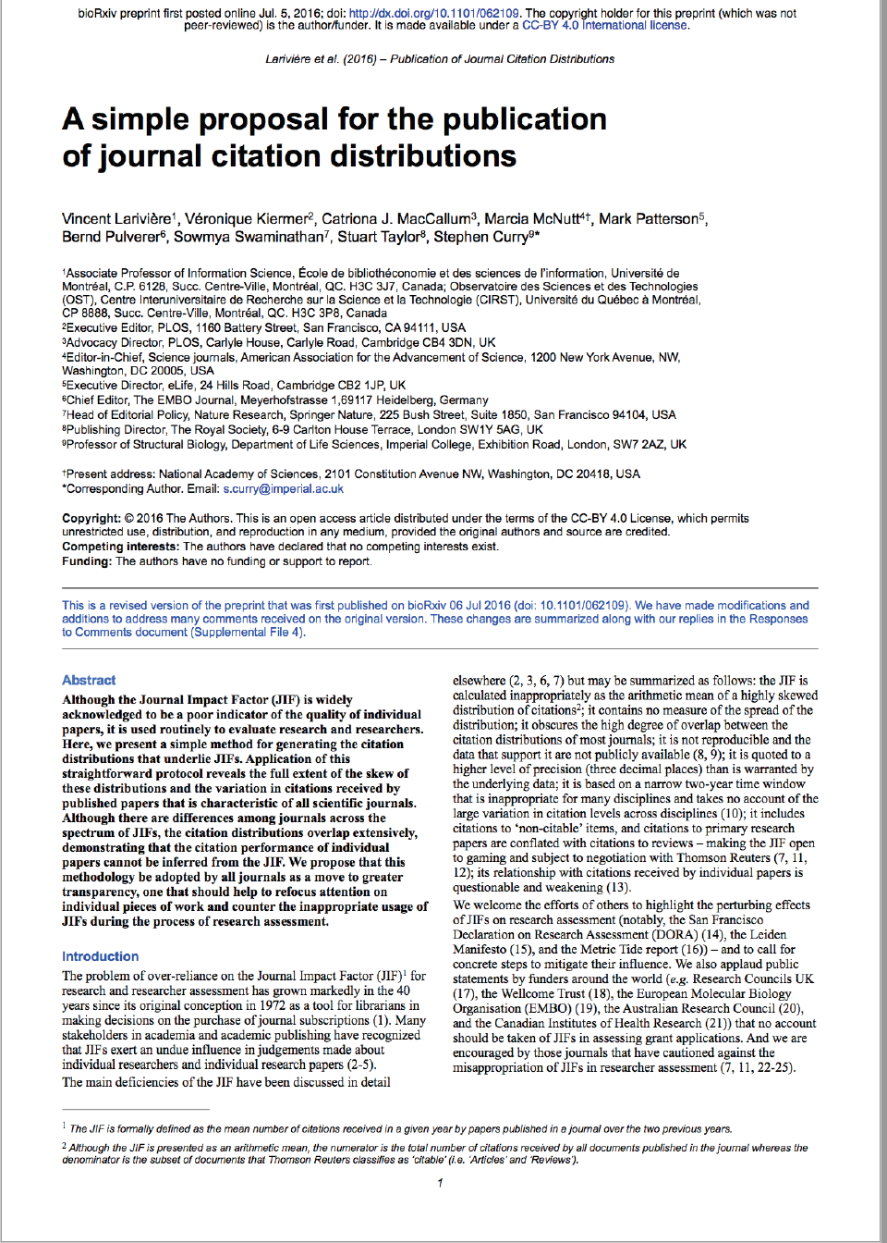
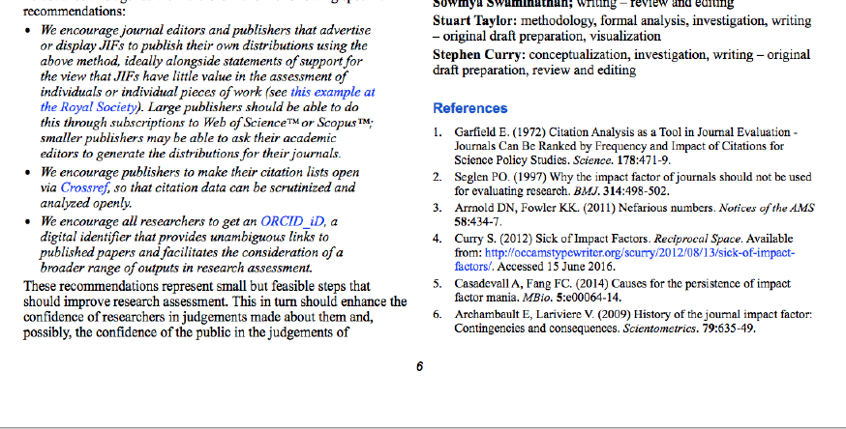
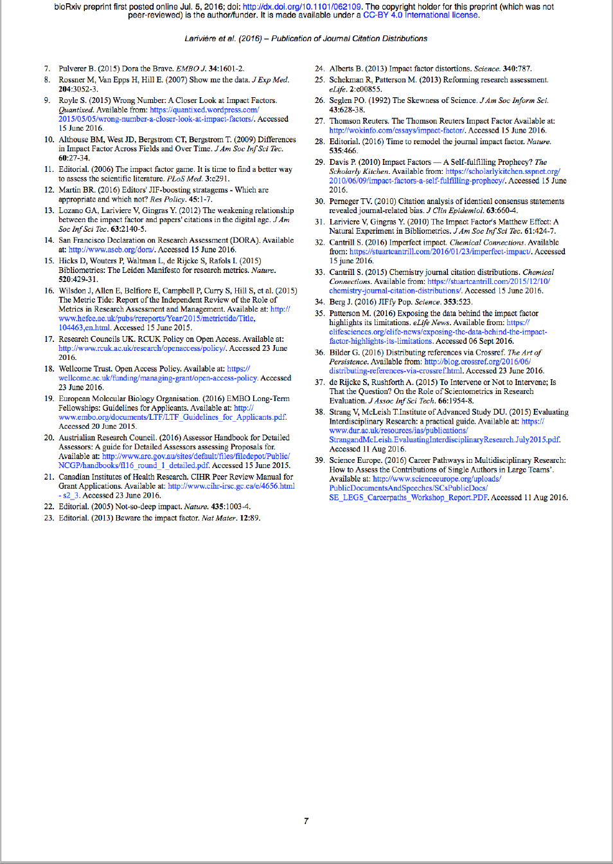
References are
Data
Between scholars, fields and science & society
A source with which to validate a scholarly work
One of the most expertly curated sources of scholarly recommendations…

Slide 48
Current culture embeds status quo
Researchers gain from publishing in ‘designer’ journals
Citation bias (conscious & sub-conscious)
Evaluation bias
Journals gain financially from their brand/ Journal Impact factor
Institutions gain financially by hiring and firing based on where researchers publish, not on what they publish (or the mission of the University)
Research assessment by funders often based on very few publications and brand/impact factor (some are changing)

Slide 49
Cultural Capital
In short, an institution officially entrusted with the transmission of the instruments of appropriations of the dominant culture which neglects methodically to transmit the instruments indispensable to the success of its undertaking is bound to become the monopoly of those social classes capable of transmitting by their own means, that is to say by that diffuse and implicit continuous educational action which operates within cultured families (often unknown to those responsible for it and to those who are subjected to it), the instruments necessary for the reception of its message, and thereby to confirm their monopoly of the instruments of appropriation of the dominant culture and thus their monopoly of that culture ….
Lack of transparency about evaluation and what constitutes merit maintains the power imbalance and inequity of opportunity in academia
‘the rich get richer’
Bourdieu, P. (1973). Cultural Reproduction and Social Reproduction. In R. Brown (Ed.), Knowledge, Education, and Cultural Change (pp. 71-112). London: Tavistock Publications Limited.
Bourdieu, P. (1984). Distinction: A social critique of the judgment of taste. Cambridge, Mass.: Harvard University Press.
Notes:
Institutions
Funders
Publishers
ECRs
Global distribution of knowledge

Slide 50
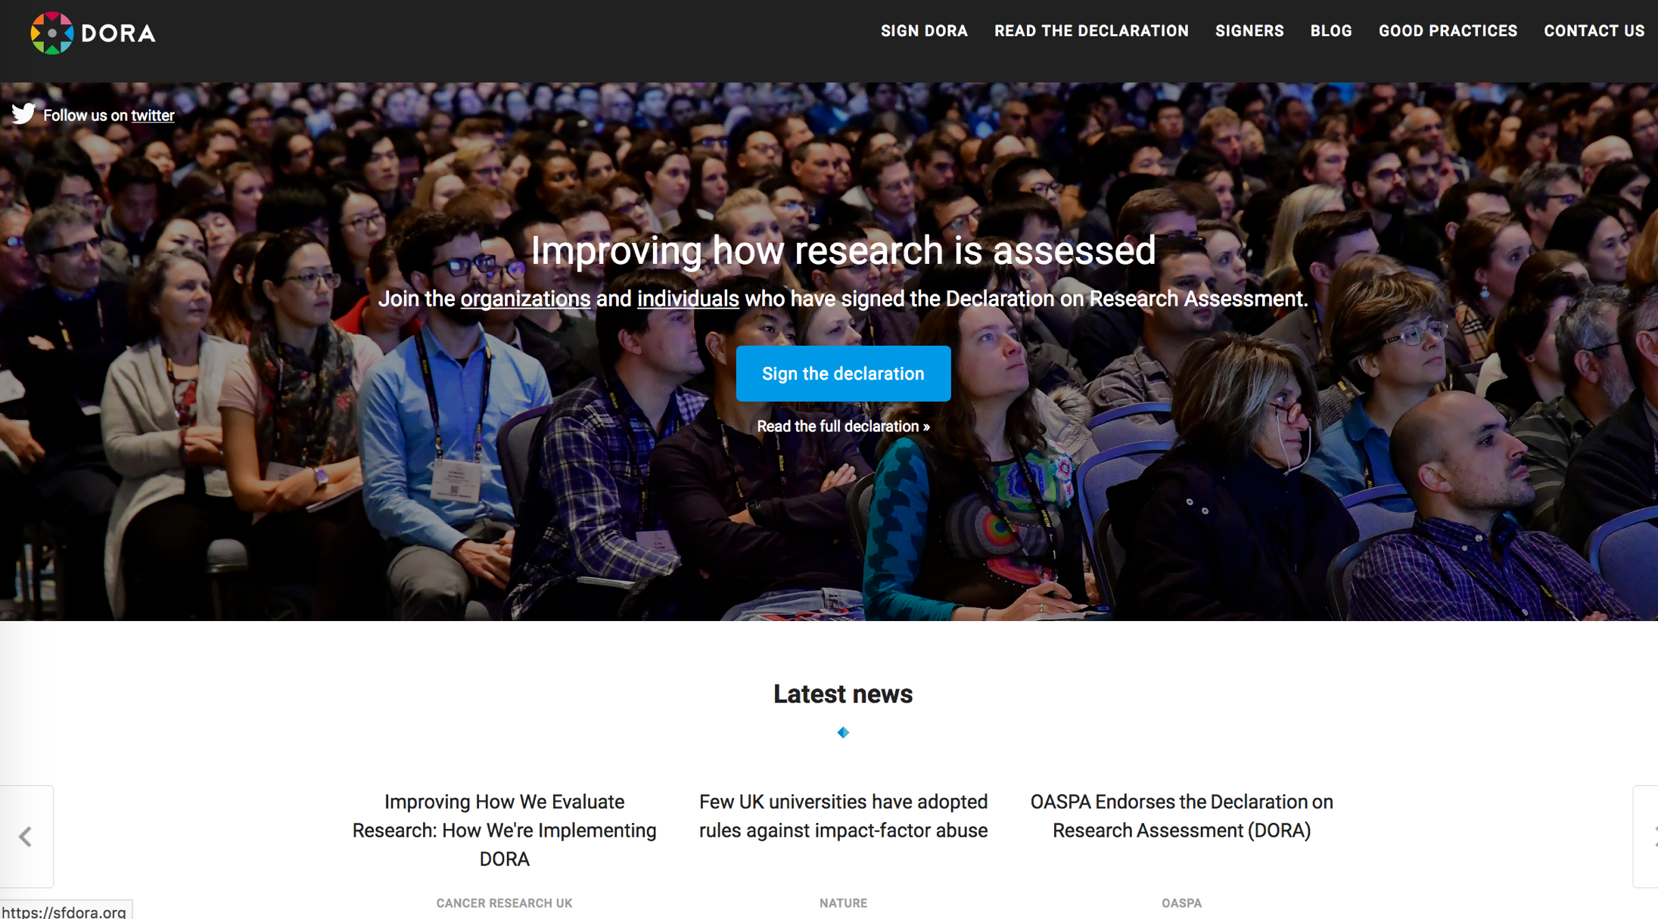
DORA

Slide 51
Reducing inequality of opportunity
Open Infrastructure
Open Source
Open Metadata
Open Data
Open Access
Open Citations
ABC news: http://www.abc.net.au/news/2018-04-13/cultural-capital/9613460 (not sure about copyright)

Slide 52
Weds hack day: Provide a ‘simple’ open source user interface for anyone to query/extract citation data….
Notes:
Institutions
Funders
Publishers
ECRs
Global distribution of knowledge

Slide 53
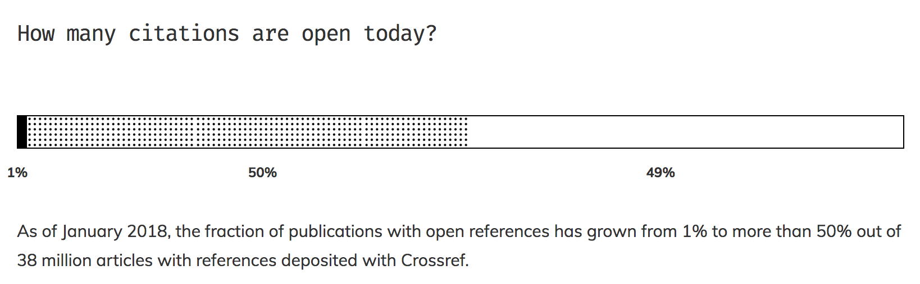
The Initiative for Open Citations • I4OC
Making tens of millions of machine-readable citation metadata openly available to everyone, with no copyright restriction.
PROGRESS OF THE INITIATIVE FOR OPEN CITATIONS • http://i4oc.org

Slide 54
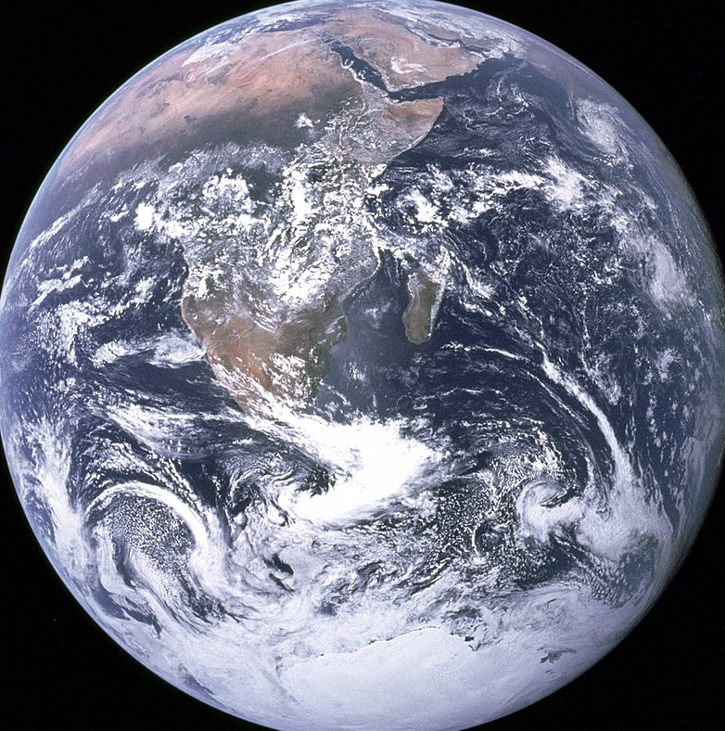

Cultural Change
Top-down
Policy
Technology
Infrastructure
Government
Funders
Institutions
Publishers
Researchers
Public
People
Bottom-up
By NASA/Apollo 17 crew; taken by either Harrison Schmitt or Ron Evans - http://web.archive.org/web/20160112123725/http://grin.hq.nasa.gov/ABSTRACTS/GPN-2000-001138.html (image link);

Slide 55
Thank you
C.J. MacCallum (2018) Open Citations as Academic & Cultural Capital: reducing inequality in the communication & evaluation of science Bologna Open Citations Workshop 3-4th Sept 2018 [CC BY 4.0]*
Acknowledgments The I4OC founders: OpenCitations, Wikimedia Foundation, PLOS, eLife, DataCite, the Center for Culture and Technology at Curtin University.
The I4OC instigators: Jonathan Dugan, Martin Fenner, Jan Gerlach, Catriona MacCallum, Daniel Mietchen, Cameron Neylon, Mark Patterson, Michelle Paulson, Silvio Peroni, David Shotton, Dario Taraborelli The I4OC stakeholders (i4oc.org/#stakeholders) and participating publishers (i4oc.org/#publishers)
*Except where noted on the slide
Notes:
[Thank you and colophon]

Slide 56
Hypercompetition
false discoveries can be generated by perfectly well-intentioned researchers. These are easy to spot when the results are absurd [ref 55]:
One mature Atlantic Salmon (Salmo salar) participated in the fMRI study. The salmon was approximately 18 inches long, weighed 3.8 lbs, and was not alive at the time of scanning. The task administered to the salmon involved completing an open-ended mentalizing task. The salmon was shown a series of photographs depicting individuals in social situations with a specified emotional valence. The salmon was asked to determine what emotion the individual in the photo must have been experiencing. Stimuli were presented in a block design with each photo presented for 10 seconds followed by 12 seconds of rest. A total of 15 photos were displayed. Total scan time was 5.5 minutes.
for example, following standard methods for their fields, researchers have observed a dead Atlantic salmon exhibiting neural responses to emotional stimuli [55]
Smaldino, Paul E., and Richard McElreath. “The Natural Selection of Bad Science.” Royal Society Open Science 3, no. 9 (September 21, 2016). https://doi.org/10.1098/rsos.160384.
Notes:
Institutions
Funders
Publishers
ECRs
Global distribution of knowledge

